Slide 1
Interface-related phenomena in magnetism
Team member:
报告人：Wu Da (吴达)
Aiqi Hu (胡爱芹)
Yihan Cheng (程奕涵)
Bowei Cheng (程博伟)
Ziqing Zhu (朱子青)
Notes:
今天给大家讲一讲一下界面相关的磁现象。界面相关的磁现象有很多，比如复杂的自旋结构，自旋输运，超快磁动力学啥的，今天我们都不讲，我们就讲讲一些比较基（简）础（单）的界面相关现象。

Slide 2
Outline
Introduction of magnetism
Interfacial magnetism tailoring and imaging
Notes:
今天给大家讲一讲一下界面相关的磁现象。界面相关的磁现象有很多，比如复杂的自旋结构，自旋输运，超快磁动力学啥的，今天我们都不讲，我们就讲讲一些比较基（简）础（单）的界面相关现象。

Slide 3
Outline
Introduction of magnetism
Interfacial magnetism tailoring and imaging
Notes:
今天给大家讲一讲一下界面相关的磁现象。界面相关的磁现象有很多，比如复杂的自旋结构，自旋输运，超快磁动力学啥的，今天我们都不讲，我们就讲讲一些比较基（简）础（单）的界面相关现象。

Slide 4
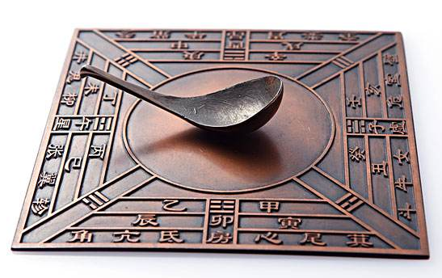
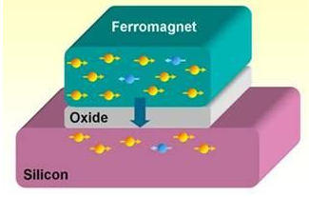
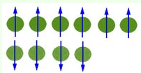
Magnetic Origin:
Atomic magnetic moment
Unfilled electron shell
Example：Fe（26）: 1s2 2s2 2p6 3s2 3p6 4s2 3d6
Notes:
3d壳层外各层均被电子填满，自旋磁矩相互抵 消;
某些元素，如锌，具有各层都充满的电子壳层 结构，其电子磁矩相互抵消，因而不显磁性。
物质的磁性是物质的基本特性之一，从战国时期应用司南到现代自旋电子器件，磁性的应用及讨论十分重要。那么物质的磁性来源于什么。。。。

Slide 5
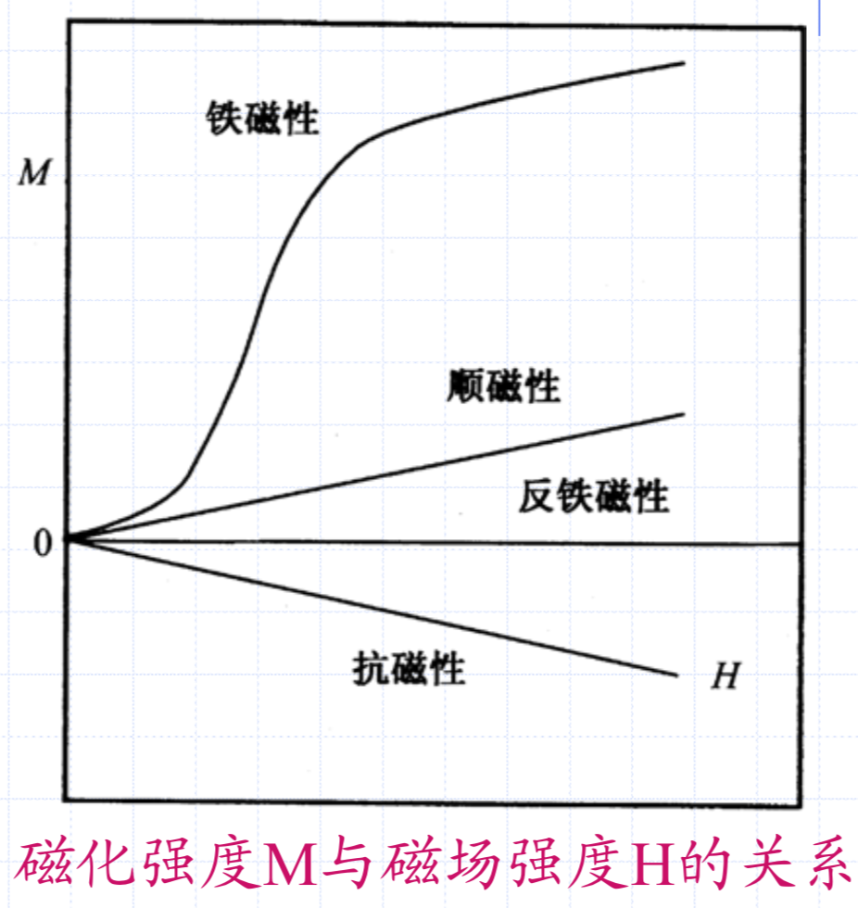
Magnetic Materials Category:
Anti-magnetic ，Paramagnetic， Ferromagnetic， Anti-ferromagnetic， Ferrimagnetic
Notes:
抗磁性 顺磁性 铁磁性 反铁磁性 亚铁磁性

Slide 6
Below Curie point or Neil point, ferromagnetic, antiferromagnetic, ferromagnetic spin arrangement diagram:
铁磁性材料磁化矢量示意图
Notes:
诸如Fe、Co、Ni、Y等材料在外磁场作用下，会产生很大的磁化强度，外磁场去除后仍能保持相 当大的永久磁性，称其为铁磁性。
铁磁性材料的磁化率可以高达10⁶; 其磁化强度远大于磁场强度。
铁磁材料具有一个磁性转变温度Tc称为居里温 度。 T<Tc 时表现出铁磁性，而T>Tc 时铁磁性消失 而呈现顺磁性。
反铁磁性是指由于电子自旋反向平行排列。在同一子晶格中有自发磁化强度，电子磁矩是同向排列的；在不同子晶格中，电子磁矩反向排列。两个子晶格中自发磁化强度大小相同，方向相反，整个晶体对外不显磁性 。
分子场假说: 铁磁材料在一定温度范围内(0K至Tc)存在与外加磁场无关的自发磁化， 导致自发磁化的相互作用力假定为材料内部存在分子场，其数量级大小为10⁹A/m，
原子磁矩在分子场作用下，克服热运动的无序效应， 自发地平行一致取向。
居里温度的本质是铁磁材料内静电交换作用强在宏观上的表现，交换作用越强，就需要越大的 热能才能破坏这种作用，宏观上就表现出居里温度越高。

Slide 7
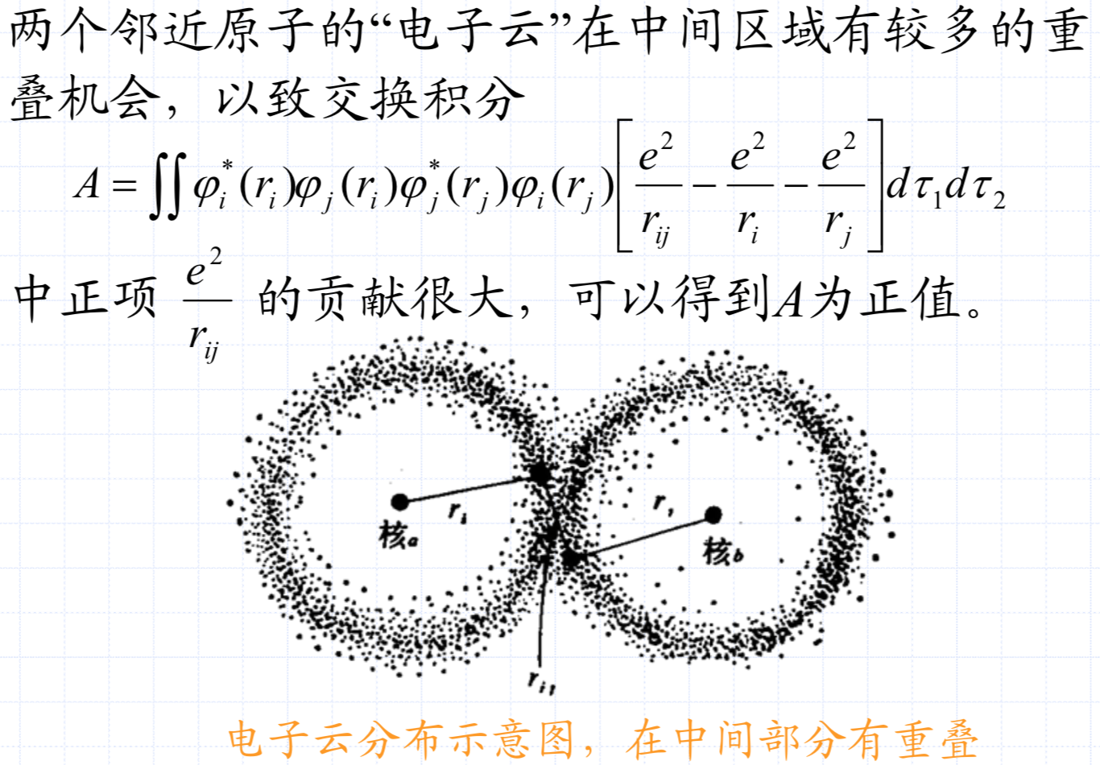
Exchange effect:
处于不同原子间的、未被填满壳层上的电子 发生特殊的相互作用。
在晶体内，参与这种相互作用的电子已不再局限于原来的原子，而是“公有化”了。原子间好像在交换电子，故称为交换作用。

Slide 8
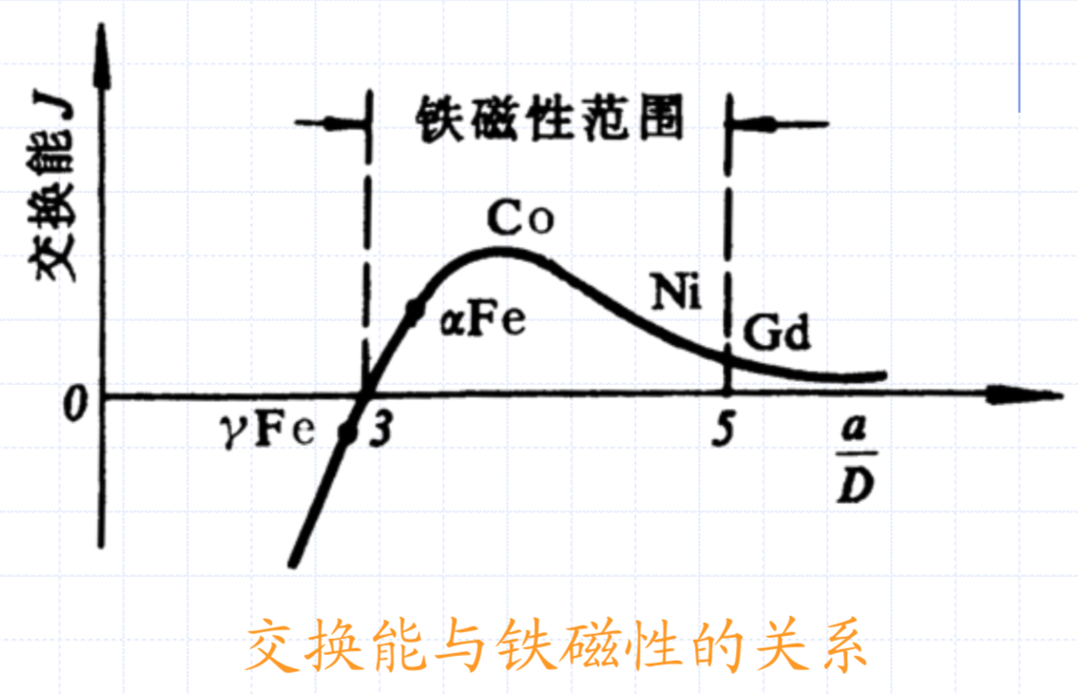
Relationship between exchange energy and atomic distance：
Notes:
当距离很大时，J 接近于零。
随着距离的减小，相互作用有所增加，J 为正值，呈现铁磁性。
距离很小时， J 为负值，这时呈现反铁磁性。

Slide 9
Magnetic domain： When cooled below Curie temperature, the magnetization of ferromagnetic material divides into many small regions called magnetic domains
Magnetic domain walls：
The regions separating magnetic domains
Bloch walls for perpendicularly magnetized films
Ne´el walls for in-plane magnetized films
Notes:
另外，磁性材料的磁性能由磁畴结构所决定。也就是说研究表面磁畴的形状大小和分布随外磁场的变化对改进磁性材料性能有重要的指导作用。
布洛赫壁中磁矩的过渡方式是始终保持平行于畴壁平面，因而在畴壁面上无自由磁极出现
在薄膜材料中，一定条件下，将会出现奈尔壁。在奈尔壁中磁矩是平行于薄膜表面逐步过渡的

Slide 10
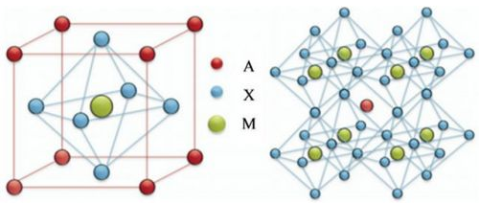
“Superexchange” theory： take perovskite structure as example
Notes:
钙钛矿型复合氧化物ABO3是一种具有独特物理性质和化学性质的新型无机非
金属材料，A位一般是稀土或碱土元素离子，M位为过渡元素离子，X为氧离子。
A位和M位皆可被半径相近的其他金属离子部分取代而保持其晶体结构基本不变

Slide 11
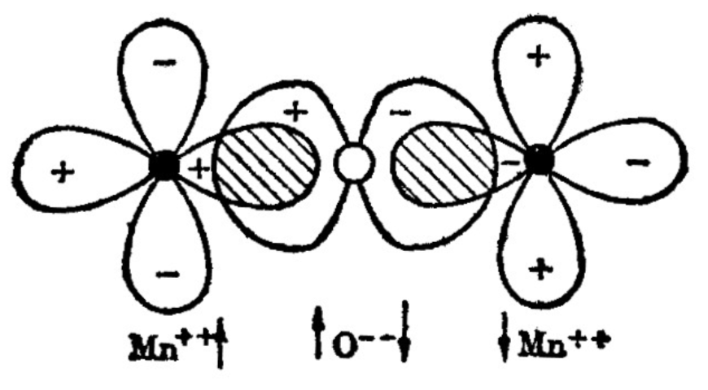
基态Mn²⁺（3d⁵）
基态O²⁻（3P⁶）
激发态Mn¹⁺（3d⁶）
激发态O¹⁻（3P⁵）
Notes:
容易看出，这种离子间的距离比之平行自旋的离子 间距要大。
根据前面的讨论，交换能的大小取决于原(离)子间 距，相距远的交换作用小
怎样解释这种离子间所具有的较大的交换能呢?
人们提出了间接交换理论，也称超交换理论。根据此理论，能够通过邻近阴离子的激发态而完成间接交换作用，
即经中间的激发态氧离子的传递交换作用，把相 距较远无法直接发生交换作用的两个金属离子的 自旋系统连接起来。

Slide 12
Magnetic properties of the film:
随着薄膜厚度的减小，Tc和Tn的变化很常见（Charilaou and Hellman, 2013, 2014）
原因：这可能是由于结构变化具有厚度或界面效应如相互扩散，粗糙度和应变
Notes:
这种内在效应可能是由于地表和近地表原子的邻居减少，晶场的变化（Pothuizen，Cohen和Sawatzky，1995），自旋轨道耦合（Marynowski等，1999）或相关效应。

Slide 13
A perovskite interface:
Notes:
界面引起的电子结构，轨道占有率和原子结构的变化，如图4所示 在控制界面磁性中的关键作用，并可能导致行为，而不是两个相邻材料的性质的简单内插。在氧化物界面处，电荷转移可以由化学势的差异或局部偶极子的屏蔽来驱动。 电荷转移可以改变界面附近的B位价态，从而使磁序不同于任一组分，例如导致铁磁性局限于两个绝缘反铁磁体之间的界面（Salvador等人，1999; Lin， 冈本和米利斯，2006年;桑托斯等人，2011年）或从顺磁性金属和反铁磁绝缘子铁磁性（高桥，川崎，和Tokura，2001年; Nanda，Satpathy和Springborg，2007年; Freeland等人，2010年; 等，2012）。
#：（At oxide interfaces, charge transfer can be driven by a difference in chemical potential or by screening of local dipoles. Charge transfer can alter the B-site valence states near the interface, enabling magnetic order that is distinct from either constituent, for instance, leading to ferro- magnetism confined to the interface between two insulating antiferromagnets (Salvador et al., 1999; Lin, Okamoto, and Millis, 2006; Santos et al., 2011) or ferromagnetism from a paramagnetic metal and antiferromagnetic insulator (Takahashi, Kawasaki, and Tokura, 2001; Nanda, Satpathy, and Springborg, 2007; Freeland et al., 2010; He et al., 2012). ）

Slide 14
Outline
Introduction of magnetism
Interfacial magnetism tailoring and imaging
Notes:
今天给大家讲一讲一下界面相关的磁现象。界面相关的磁现象有很多，比如复杂的自旋结构，自旋输运，超快磁动力学啥的，今天我们都不讲，我们就讲讲一些比较基（简）础（单）的界面相关现象。

Slide 15
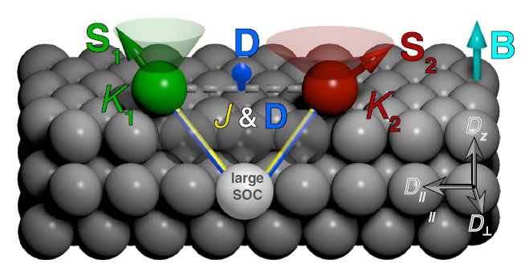
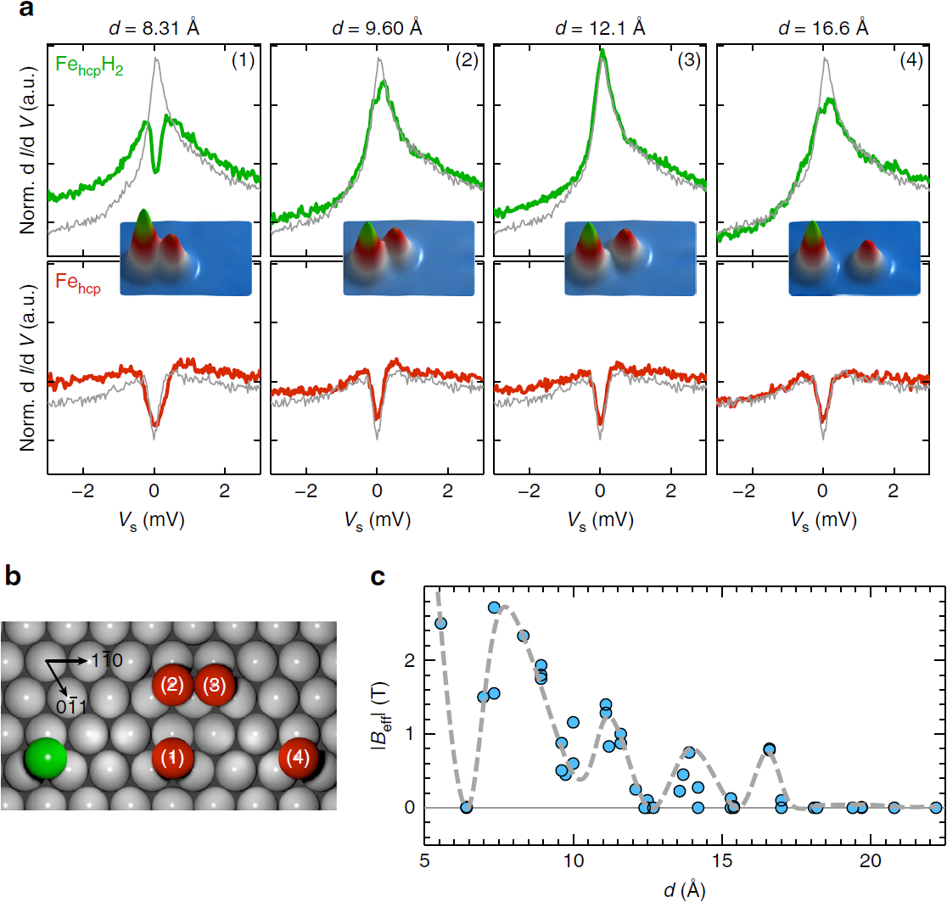
Interface-related Dzyaloshinskii–Moriya interaction
Kondo resonance
Green: $FeH_{2}$
Red: $Fe$
Substrate: Pt(111)
UHV
$$0.3 K$$
$B_{z}$ up to $12 T$
$$\hat{H}=−J\left(\hat{{\overset{⃑}{S}}_{1}}∙\hat{{\overset{⃑}{S}}_{2}}\right)−\overset{⃑}{D}∙\left(\hat{{\overset{⃑}{S}}_{1}}×\hat{{\overset{⃑}{S}}_{2}}\right)+\sum_{i=1}^{2}{\left(K_{i}{\left(\hat{{\overset{⃑}{S}}_{i,z}}\right)}^{2}−g_{i}μ_{B}\hat{{\overset{⃑}{S}}_{i}}∙\overset{⃑}{B}\right)}$$
Excitations to first excited state
Wiebe J, Khajetoorians A A, Steinbrecher M, et al. Tailoring the chiral magnetic interaction between two individual atoms[J]. Nature Communications, 2016, 7:10620.
Notes:
fcc abc
hcp ab
It decomposes into an isotropic Heisenberg exchange interaction term ($J$), which takes into account the usual RKKY-like exchange that favours collinear orientations, a DMI term ($\overset{⃑}{D}$), which favours non-collinear spin orientations, a single spin magnetic anisotropy term ($K_{i}$), which locks each spin in a given orientation resulting from the interaction with the crystal field, and a Zeeman term, which considers the response of each spin to a magnetic field $\overset{⃑}{B}$ as determined by the g-factors $g_{i}$ and the Bohr magneton $μ_{B}$.
The overall $J$ and $\overset{⃑}{D}$ are given by the contributions of all substrate atoms resulting in a nonzero $\overset{⃑}{D}=(D_{∥},D_{⊥},D_{z})$ (orientation of the components as indicated) because of broken inversion symmetry at the surface. The orientation of the spins $\hat{{\overset{⃑}{S}}_{1}}$ and $\hat{{\overset{⃑}{S}}_{2}}$ of the coupled pair is determined by the interplay between the single ion magnetic anisotropy of each atom ($K_{i}$), $J$, $\overset{⃑}{D}$, and the applied magnetic field ($B_{z}$).
The DMI is a fundamental ingredient responsible for twisting the magnetization of two coupled spins $\hat{{\overset{⃑}{S}}_{1}}$ and $\hat{{\overset{⃑}{S}}_{2}}$, as the overall energy can be reduced between the two spins by canting their relative orientation.

Slide 16
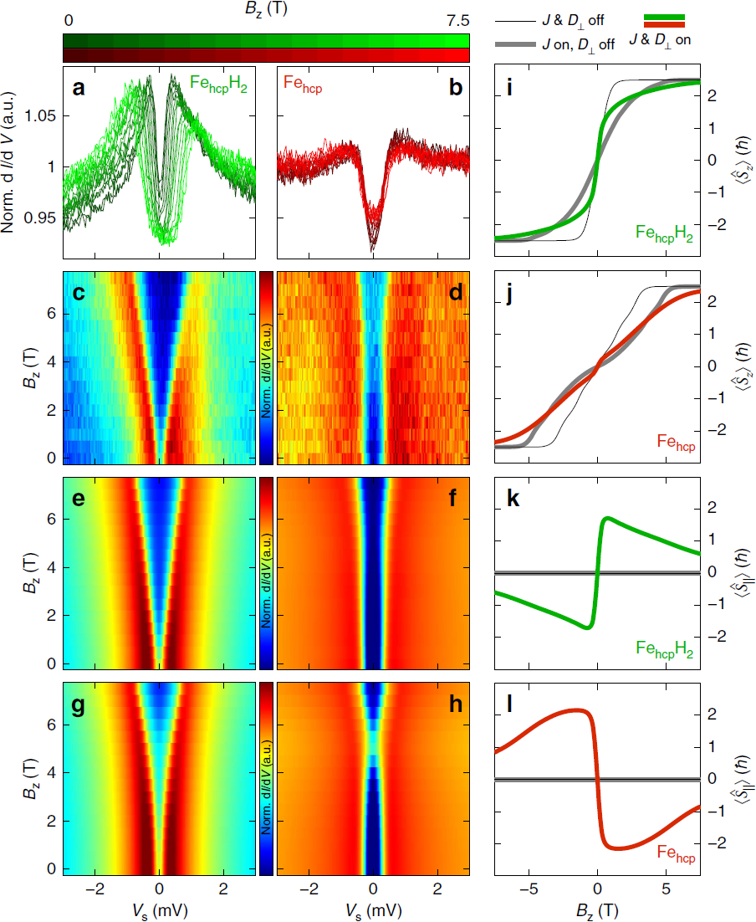
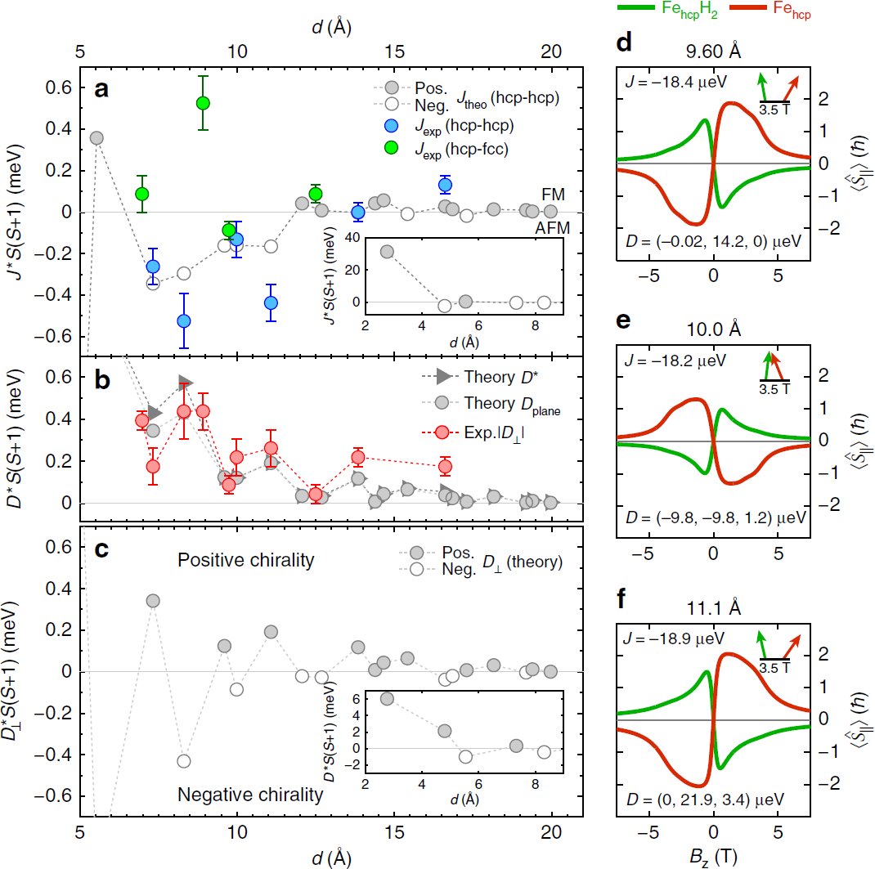
$$\hat{H}=−J\left(\hat{{\overset{⃑}{S}}_{1}}∙\hat{{\overset{⃑}{S}}_{2}}\right)−\overset{⃑}{D}∙\left(\hat{{\overset{⃑}{S}}_{1}}×\hat{{\overset{⃑}{S}}_{2}}\right)+\sum_{i=1}^{2}{\left(K_{i}{\left(\hat{{\overset{⃑}{S}}_{i,z}}\right)}^{2}−g_{i}μ_{B}\hat{{\overset{⃑}{S}}_{i}}∙\overset{⃑}{B}\right)}$$
Notes:
DMI favours a particular rotational sense of the magnetization in the pair which depends on the orientation of D, the oscillations have a direct consequence on the preferred chirality of the magnetization in the pair.

Slide 17
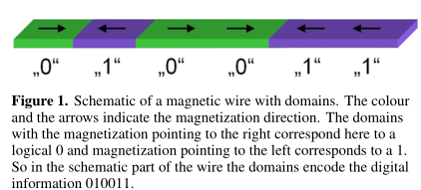
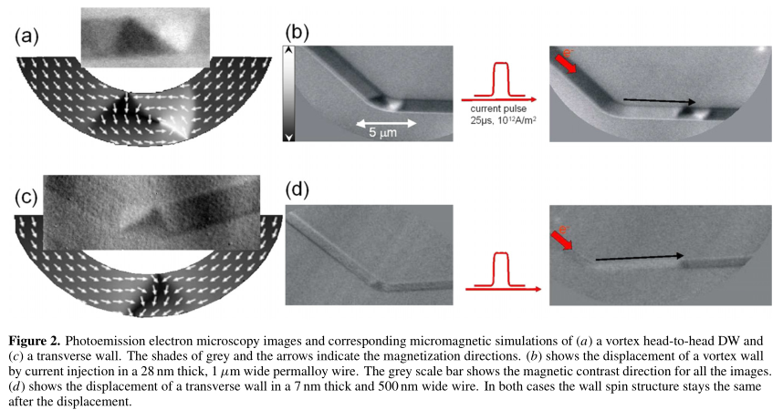
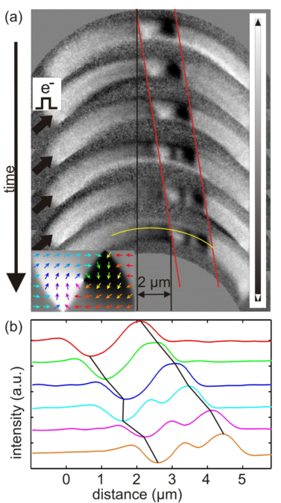
Imaging the motion of domain wall via XPEEM
Current-induced DW motion in in-plane magnetized soft-magnetic wires
Samples:Permalloy
(a): XPEEMimage of a vortex head-to-head wall (VW)
(c): transverse wall
Notes:
Thiaville A, Nakatani Y, Miltat J, et al. Micromagnetic understanding of current-driven domain wall motion in patterned nanowires[J]. EPL (Europhysics Letters), 2005, 69(6): 990.
右图：五个脉冲下磁畴壁的移动

Slide 18
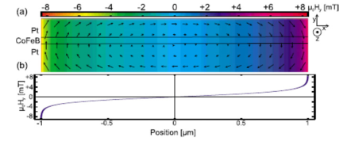
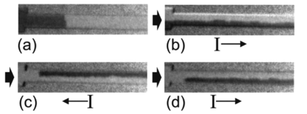
current-induced DW motion in out-of-plane magnetized wires
Sample:
out-of-plane magnetized Pt/CoFeB(0.6nm)/Pt.
(a) XPEEM magnetic images shows a magnetic image of a DW in a 2µm wide nanowire
Interestingly, when injecting successive current pulses of opposite polarities, the magnetization in the DW can be reversed back and forth by the sole effect of the Oersted field
J. Phys. D: Appl. Phys. 44 (2011) 384005
O. Boulle et al. / Materials Science and Engineering R 72 (2011) 159–187

Slide 19
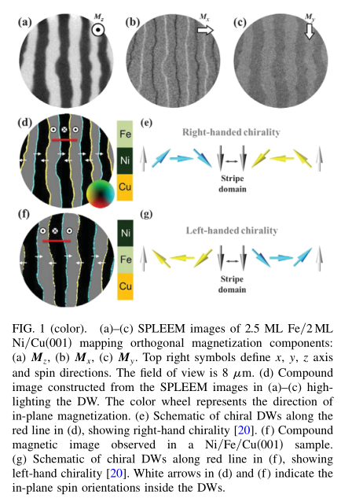
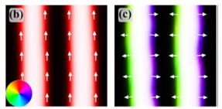
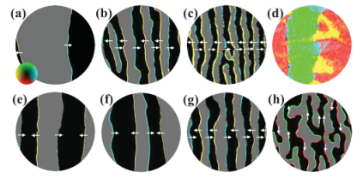
Imaging the Chiral Magnetic Domain Wall Structure via SPLEEM
SPLEEM images of Fe/Ni/Cu(001) Films
Bloch-type DWs
Ne’el-type DWs
a-d: keeping the Ni film thickness fixed at 2 monolayer (ML) and increasing the Fe layer thickness : stripe width decreases
e-f: increasing mainly the Ni film thickness while keeping the Fe layer thin
Ne’el type
Bloch type
magnetic chirality is an interfacial effect
1
Chen, G. et al. PRL 110, 177204 (2013)
Chen, G. et al. Nat. Commun. 4, 2671.
Notes:
(a)-(d): these images show that Ne´el-type DW structure and the right handed chirality are robust features of this system, consistent with the interpretation that the short-ranged DMI is the driving force of this DW chirality
By increasing mainly the Ni film thickness while keeping the Fe layer thin, the bilayer structure remains in the stripe phase over a wide thickness range. We find that the Ne´el-type DWs with right-handed chirality persist up to 7 ML Ni thickness [Figs. 3(e) to 3(g)], and then switch to the Bloch-type above 10 ML Ni thickness.

Slide 20
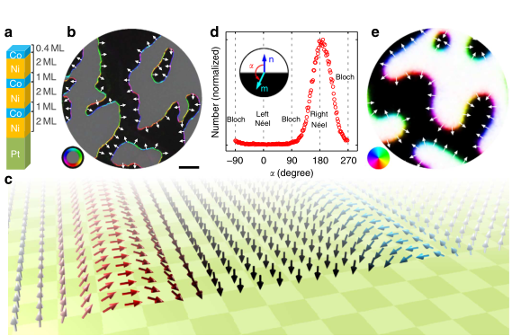
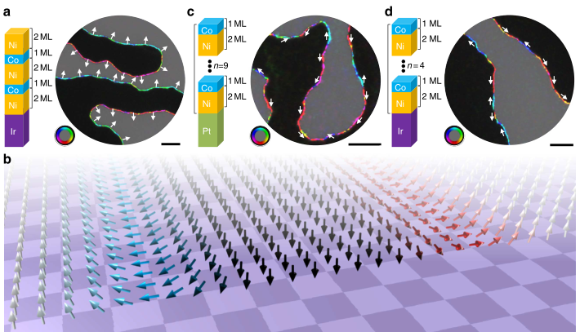
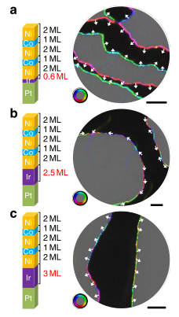
Tailoring the chirality of magnetic domain walls by interface engineering Films
Real-space observation of
chiral Ne’el walls in [Co/Ni]n multilayer
The dependence of the DW chirality on
substrates and thickness of films
Chirality as a function of Ir inserting layer thickness. (a–c)
These experiments demonstrate that interface engineering provides a way to tailor the strength and the sign of the DMI and, as a result, to control DW spin structure in magnetic materials
Chen, G. et al. PRL 110, 177204 (2013)
Chen, G. et al. Nat. Commun. 4, 2671.

Slide 21
Summary&Outlook
Modification
introduction of high spin-orbit-coupled impurity atoms at interfaces.
Imaging the motion of domain wall
electrostatic or electrochemical control of magnetism via large surface or interface electric fields
Characterization tools
real space :
STM
cross sectional transmission electron microscopy (XPEEM\ SPLEEM)
reciprocal space:
high-resolution x-ray scattering/absorption tools Macroscopic tools such as SQUID and magneto-optical Kerr effect (MOKE) magnetometry
Notes:
1. Interfacial modification of magnetic properties 实空间：扫描探针显微术和横截面的透射电子显微镜 spin-polarized low-energy electron microscopy
Chemical, charge state, and even spin-state information can be obtained, utilizing methods such as electron energy-loss spectroscopy (EELS)
These techniques have enabled substantial advances in the understanding of domain structures and interlayer magnetic coupling.

Slide 22
Reference
Wiebe J, Khajetoorians A A, Steinbrecher M, et al. Tailoring the chiral magnetic interaction between two individual atoms[J]. Nature Communications, 2016, 7:10620.
Malinowski G, Boulle O, Kläui M. Current-induced domain wall motion in nanoscale ferromagnetic elements[J]. Journal of Physics D: Applied Physics, 2011, 44(38): 384005.
Chen G, Zhu J, Quesada A, et al. Novel chiral magnetic domain wall structure in Fe/Ni/Cu (001) films[J]. Physical review letters, 2013, 110(17): 177204.
Wang W G, Li M, Hageman S, et al. Electric-field-assisted switching in magnetic tunnel junctions[J]. Nature materials, 2012, 11(1): 64-68.
Hsu P J, Kubetzka A, Finco A, et al. Electric-field-driven switching of individual magnetic skyrmions[J]. Nature nanotechnology, 2016.

Slide 23
Thanks!

